Slide 1

Time Series Forecasting Platform
(Brent Crude Oil)
Akil Mohamed Firos
Student id - 219015127
MSc AI for Business Intelligence
Academic Supervisor - Andrew Morozov
Sprint 4.1 Validation and Visualisation

Slide 2
Table of Contents
Objectives & Methodology
Out-of-Time Trajectory Analysis
Cross-Era Performance Indicators
Model Stability & Predictor Drivers

Slide 3
Objectives & Methodology
Sprint Goal: Stress-test the best-performing models on an unseen secondary dataset to verify generalization and guard against modern-era overfitting.
Secondary Dataset Setup:
  Era: Historical Market Regime (2007–2015) | $N = 437$ weekly observations.
  Context: Encompasses the 2008 Great Financial Crisis, capturing extreme Brent crude price swings (peaking at >$140/bbl before dropping to ~$35/bbl).
Validated Models: Selected top-performing tree-based architecture LightGBM and XGBoost.

Slide 4
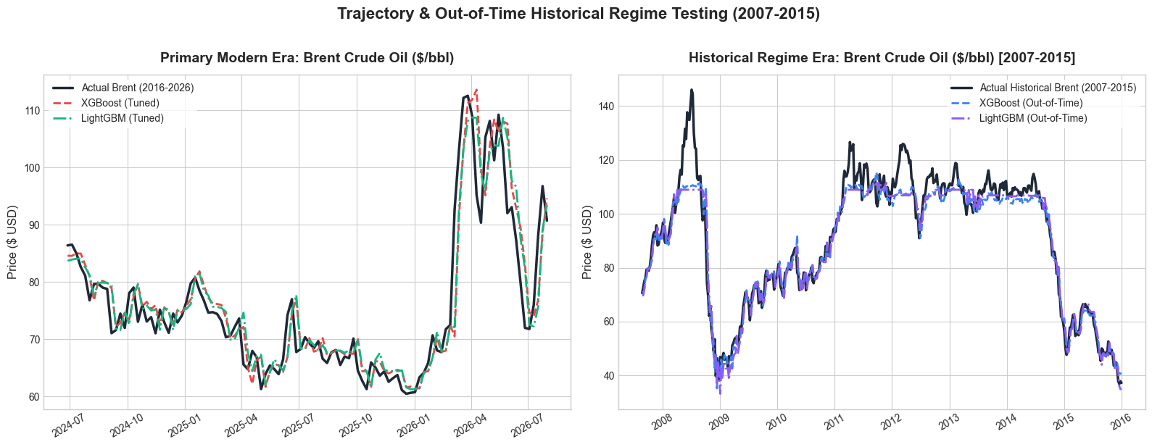
Out-of-Time Trajectory Analysis
Modern Era (2016–2026):
  Both models closely follow modern price dynamics ($ MAE ~3.40$).
  LightGBM slightly edges out XGBoost on overall error fit ($RMSE = 4.85$ vs. 5.07$).
Historical Crisis Era (2007–2015):
  Neither model diverged during rapid structural shifts or market crashes.
  High-volatility peaks produced temporary under-prediction, typical of non-linear tree models encountering extreme unseen price ceilings.

Slide 5

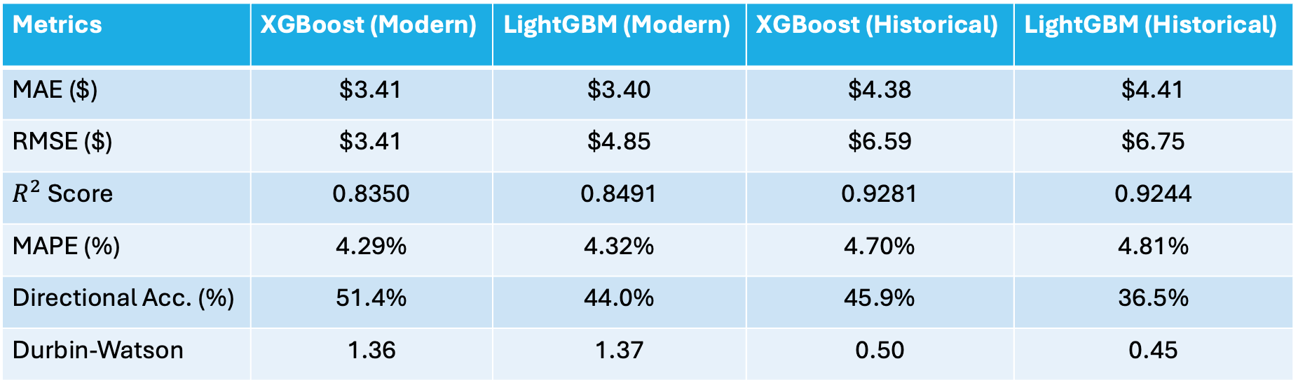
Cross-Era Performance Indicators
Metrics | XGBoost (Modern) | LightGBM (Modern) | XGBoost (Historical) | LightGBM (Historical)
MAE ($) | $3.41 | $3.40 | $4.38 | $4.41
RMSE ($) | $3.41 | $4.85 | $6.59 | $6.75
$R^{2}$Score | 0.8350 | 0.8491 | 0.9281 | 0.9244
MAPE (%) | 4.29% | 4.32% | 4.70% | 4.81%
Directional Acc. (%) | 51.4% | 44.0% | 45.9% | 36.5%
Durbin-Watson | 1.36 | 1.37 | 0.50 | 0.45
Key Take aways:
Strong Trend Capture: $R^{2}$increased to >0.92 in the historical era, confirming excellent fit across wide swings.
Stable Scale Error: MAPE remained under 4.81% across all testing environments.
Absolute Error Increase: Absolute dollar errors (MAE/RMSE) rose during 2007–2015 due to higher nominal oil prices during that era.

Slide 6
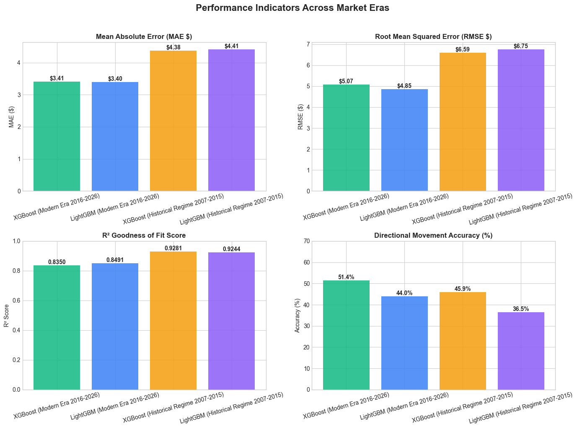

Slide 7
Model Stability & Predictor Drivers
Error Density Symmetry:
  Residual error distributions for both eras are narrow, zero-centered bell curves, showing negligible systematic bias.
  Historical residuals exhibit slightly broader tails due to 2008 volatility spikes.
Feature Drivers:
  Price_Lag_1 dominates feature importance for LightGBM, backed by macroeconomic features (VIX_Z, OPEC_Z, and USD_Z).
Autocorrelation (Durbin-Watson):
  Scores near ~1.37 in the modern era indicate mild positive autocorrelation, while historical scores (~ 0.45 - 0.50) reflect error persistence during crisis regimes.

Slide 8


